Slide 1
AIM
To assess the prescribing patterns, dispensing frequency, and consumption of antihypertensive medications in order to inform drug forecasting, enhance monitoring practices, and optimize resource allocation.

Slide 2
Specific Objectives
To describe the demographic characteristics( age, gender) of patients receiving antihypertensive medications during the study period (Feb.2024 – September 2024)
To evaluate the types and strengths of antihypertensive drugs prescribed and dispensed during the study period, and to identify the most frequently prescribed antihypertensive drugs.
To identify cases of early refills for each antihypertensive medications and determine the amount lost due to early refills
To determine the consumption rate of the antihypertensive medications in the clinic
To provide recommendations based on findings

Slide 3
Procedure
The dispensing data of antihypertensives from February 2024 to September, 2024 was abstracted from the record book and entered into a spreadsheet.
Information entered- Personal number, Gender, Age, Date of dispensing, Antihypertensives dispensed and the quantity( 0.5 for 2 weeks, 1 for one month, 2 for two months and so on)
The data was cleaned and analyzed using Microsoft Excel and Python packages for data and statistical analysis (Numpy, Pandas, Scipy, Matplotlib)

Slide 4
Findings
Demographic characteristics (gender) of patients receiving antihypertensive medications during the study period (February 2024 – September 2024).
Gender | Count
Male | 2196
Female | 1802
Summary
The clinic saw more male patients with hypertension than female patients during the study period

Slide 5
Findings
Demographic characteristics (age) of patients receiving antihypertensive medications during the study period (February 2024 – September 2024).
Statistics
Mean | 63.75
Standard deviation | 10.29
Median | 65.00
Max | 92.00
Min | 15.00
Summary
The mean age of antihypertensive patients visiting the clinic during the study period is 64.

Slide 6
Findings
A comparative analysis of patients' gender and age- Independent sample t-test
Gender | Mean | T-statistics | P-value | Significance
Male | 66.04 | 15.9901 | 0.0000 | Yes
Female | 60.97
Summary
The male patients had a significantly higher mean age than the female patients, suggesting that generally the clinic sees more older male patients with hypertension than female patients.

Slide 7
Findings
Evaluation of the types of antihypertensive drugs prescribed and dispensed
Medication | Two weeks | One month | Two months | Three months | Four months | Total
Amlodipine 10mg | 130 | 2233 | 6 | 0 | 0 | 2369
Losartan 50mg | 44 | 737 | 9 | 0 | 0 | 790
Lisinopril 10mg | 61 | 575 | 5 | 0 | 1 | 642
Amlodipine 5mg | 44 | 476 | 0 | 0 | 0 | 520
Indapamide 1.5mg | 16 | 465 | 5 | 0 | 0 | 486
Bendroflumethiazide 2.5mg | 2 | 462 | 6 | 2 | 1 | 474
Bisoprolol 2.5mg | 28 | 335 | 3 | 2 | 4 | 372
Lisinopril 5mg | 0 | 282 | 0 | 0 | 0 | 282
Normoretic | 11 | 219 | 6 | 0 | 0 | 236
Losartan 100mg | 26 | 207 | 0 | 0 | 0 | 233
Telmisartan 80mg | 5 | 121 | 3 | 0 | 0 | 129
Spirinolactone | 11 | 100 | 4 | 1 | 0 | 116
Hydrochlorothiazide 25mg | 40 | 31 | 0 | 0 | 0 | 71
Valsartan 160mg | 0 | 67 | 1 | 0 | 0 | 68
Nifedipine XL 30mg | 0 | 58 | 4 | 1 | 0 | 63
Nifedipine 20mg | 1 | 52 | 2 | 2 | 1 | 58
Methyldopa 250mg | 0 | 39 | 7 | 2 | 7 | 55
Candesartan 16mg | 0 | 53 | 1 | 0 | 0 | 54
Aprovasc | 0 | 49 | 2 | 1 | 0 | 52
Co-diovan | 1 | 47 | 3 | 0 | 1 | 52
Summary
Amlodipine 10mg were prescribed and dispensed 2369 times within the timeframe this study was conducted

Slide 8
Findings
On the average what percentage of hypertensive patients who visit the clinic per day collect a particular drug, say amlodipine ?
What is the probability that an anti-hypertensive patient in the clinic takes a particular drug, say amlodipine?
Medication | Average Daily Percentage (%) | Probability
Amlodipine 10mg | 59.4 | 0.6
Lisinopril 10mg | 20.2 | 0.2
Losartan 50mg | 16 | 0.2
Indapamide 1.5mg | 12.5 | 0.1
Bendroflumethiazide 2.5mg | 12.4 | 0.1
Amlodipine 5mg | 12 | 0.1
Bisoprolol 2.5mg | 9.7 | 0.1
Losartan 100mg | 7.2 | 0.1
Lisinopril 5mg | 6.4 | 0.1
Normoretic | 5.7 | 0.1
Out of every 100 hypertensive patients that visit the clinic in a day, about 60 of them collect Amlodipine 10mg
The probability that a hypertensive patient that walks into the clinic in a day collects Amlodipine 10mg is 0.6

Slide 9
Findings
Days of the week and filled antihypertensive prescriptions
Day Of Week | Count
Monday | 851
Tuesday | 825
Thursday | 823
Wednesday | 759
Friday | 740
Summary
Antihypertensive medications were most filled on Mondays and least on Fridays

Slide 10
Findings
Detection of cases of early refills
Medication | Early Refills
Amlodipine 10mg_Early | 456
Losartan 50mg_Early | 119
Lisinopril 10mg_Early | 102
Indapamide 1.5mg_Early | 82
Bendroflumethiazide 2.5mg_Early | 68
Bisoprolol 2.5mg_Early | 67
Amlodipine 5mg_Early | 51
Losartan 100mg_Early | 39
Normoretic_Early | 32
Spirinolactone_Early | 22
Lisinopril 5mg_Early | 22
Telmisartan 80mg_Early | 20
Nifedipine XL 30mg_Early | 15
Candesartan 16mg_Early | 11
Nifedipine 20mg_Early | 10
Aprovasc_Early | 7
Labetalol hydrochloride_Early | 7
Atenolol 100mg_Early | 6
Coveram plus(10mg/2.5mg/10mg)_Early | 6
Valsartan 80mg_Early | 6
Summary
There were 456 cases of early refill of Amlodipine 10mg

Slide 11
Findings
Tablet leftovers (The amount of medicine(tablets) remaining with the patients as of the time he/she came for the early refill) and total packs lost due to early refill
Medication | Quantity in a pack | Total tablet lost in early refill | Total packs lost
Amlodipine 10mg | 30 | 4708 | 157
Losartan 50mg | 30 | 1914 | 64
Lisinopril 10mg | 28 | 1168 | 42
Indapamide 1.5mg | 30 | 910 | 30
Bisoprolol 2.5mg | 28 | 984 | 35
Bendroflumethiazide 2.5mg | 28 | 810 | 29
Amlodipine 5mg | 30 | 603 | 20
Normoretic | 100 | 356 | 4
Lisinopril 5mg | 28 | 204 | 7
Spirinolactone | 100 | 184 | 2
Telmisartan 80mg | 30 | 160 | 5
Nifedipine XL 30mg | 30 | 148 | 5
Aprovasc | 28 | 135 | 5
Nifedipine 20mg | 100 | 124 | 1
Labetalol hydrochloride | 30 | 122 | 4
Candesartan 16mg | 28 | 109 | 4
Coveram plus(10mg/2.5mg/10mg) | 30 | 85 | 3
Co-diovan | 28 | 70 | 3
Atenolol 100mg | 28 | 65 | 2
Valsartan 80mg | 28 | 63 | 2
Summary
For the period of this study, 4708 tablets which is about 157 packs of Amlodipine by 30 has been lost to early refill

Slide 12
Findings
Identification of antihypertensive medication with the highest consumption- Total packs of the medication consumed within the time frame of the study
Medication | Quantity in a pack | Total packs | Average Monthly consumption(packs)
Amlodipine 10mg | 30 | 2159 | 270
Losartan 50mg | 30 | 1,519 | 190
Lisinopril 10mg | 28 | 1184 | 148
Indapamide 1.5mg | 28 | 712 | 89
Amlodipine 5mg | 30 | 498 | 62
Bendroflumethiazide 2.5mg | 28 | 485 | 61
Bisoprolol 2.5mg | 28 | 479 | 60
Lisinopril 5mg | 28 | 130 | 16
Hydrochlorothiazide 25mg | 100 | 78 | 10
Normoretic | 100 | 69 | 9
Telmisartan 80mg | 30 | 69 | 9
Spirinolactone | 100 | 67 | 8
Valsartan 160mg | 28 | 58 | 7
Nifedipine XL 30mg | 30 | 56 | 7
Methyldopa 250mg | 100 | 56 | 7
Nifedipine 20mg | 100 | 55 | 7
Candesartan 16mg | 28 | 43 | 5
Aprovasc | 28 | 39 | 5
Co-diovan | 28 | 37 | 5
Coveram plus(10mg/2.5mg/10mg) | 30 | 35 | 4
Summary
2159 packs of amlodipine by 30 were consumed within the time frame of this study. The average monthly consumption of Amlodipine 10mg is 270 packs

Slide 13
Recommendations
1. Implementation of an Electronic Medical Record (EMR) System
2. Patient-Based Drug Bin Cards
- The bin cards records quantities dispensed and refill dates to ensure accuracy and minimize wastage.
- Patients present the card during each refill for verification and updates, ensuring consistent tracking.

Slide 14
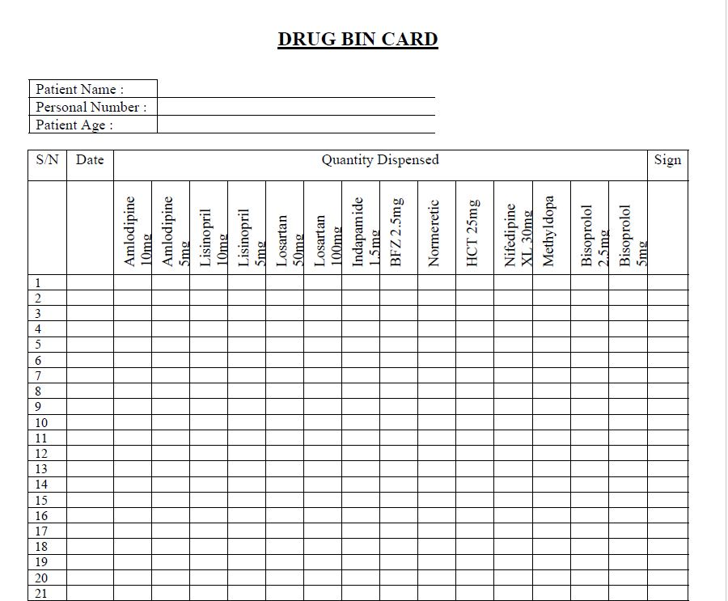
Implementable solution

